Slide 1
What is (tiny) Machine Learning?
Notes:
Welcome, in this section of the videos, I am going to focus why the future of ML is tiny and bright!
Specifically, I want to emphasize what makes tiny… really tiny? And why we want to make things tiny?

Slide 2
What is Machine Learning?
Artificial Intelligence
Machine Learning
Machine Learning is a subfield of Artificial Intelligence focused on developing algorithms that learn to solve problems by analyzing data for patterns
Notes:
Starting off with ML, recall the definition. It is all about looking for interesting patterns in the data.

Slide 3
What is (Deep) Machine Learning?
Artificial Intelligence
Machine Learning
Deep Learning
Machine Learning is a subfield of Artificial Intelligence focused on developing algorithms that learn to solve problems by analyzing data for patterns
Deep Learning is a type of Machine Learning that leverages Neural Networks and Big Data
Notes:
Specifically, we will be using DNNs… which are Neural Networks that are trained from big data. Don’t worry, we will be learning a whole lot about them pretty soon.

Slide 4


Applications of Machine Learning
Notes:
ML is everywhere
Take a picture… do something nice or tell you something nice about it.
--------
Camera: https://thenounproject.com/search/?q=camera&i=3523976
Photo: https://thenounproject.com/search/?q=photo&i=1916710
Mic: https://thenounproject.com/search/?q=mic&i=2519173
Speech Bubble: https://thenounproject.com/search/?q=text+box&i=3041656
Like/Dislike: https://thenounproject.com/search/?q=like+dislike&i=3201876 Laptop: https://thenounproject.com/search/?q=ad&i=981295

Slide 5


Applications of Machine Learning
Notes:
Talk to the machine and it responds
Camera: https://thenounproject.com/search/?q=camera&i=3523976
Photo: https://thenounproject.com/search/?q=photo&i=1916710
Mic: https://thenounproject.com/search/?q=mic&i=2519173
Speech Bubble: https://thenounproject.com/search/?q=text+box&i=3041656
Like/Dislike: https://thenounproject.com/search/?q=like+dislike&i=3201876 Laptop: https://thenounproject.com/search/?q=ad&i=981295

Slide 6


Applications of Machine Learning
Notes:
Help you have better social and web experience
Amazon, facebook etc.
--------
Camera: https://thenounproject.com/search/?q=camera&i=3523976
Photo: https://thenounproject.com/search/?q=photo&i=1916710
Mic: https://thenounproject.com/search/?q=mic&i=2519173
Speech Bubble: https://thenounproject.com/search/?q=text+box&i=3041656
Like/Dislike: https://thenounproject.com/search/?q=like+dislike&i=3201876 Laptop: https://thenounproject.com/search/?q=ad&i=981295

Slide 7
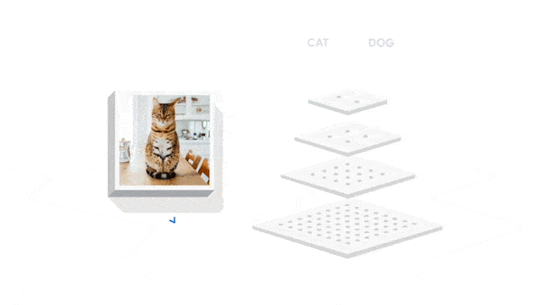
Image Classification
Notes:
https://www.tensorflow.org/about
Lawrence Moroney is checking legal @ TensorFlow (it’s his team)

Slide 8
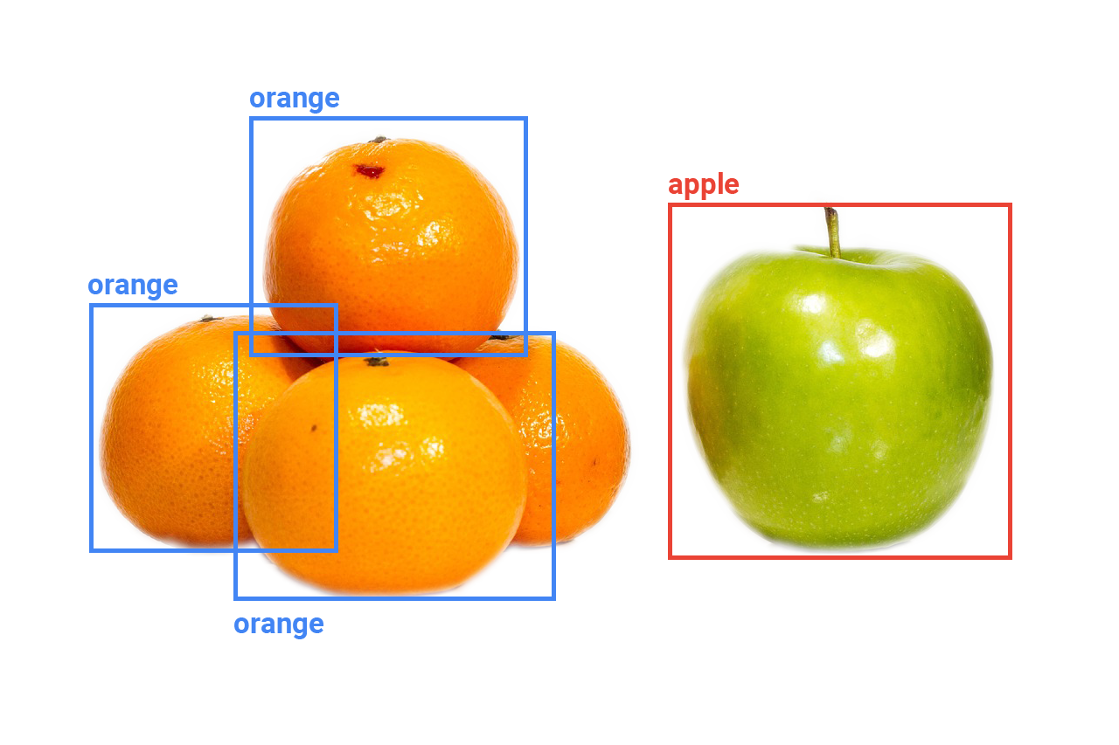
Object Detection
Notes:
https://www.needpix.com/photo/download/808441/apple-orange-fruit-free-pictures-free-photos-free-images-royalty-free-free-illustrations
This is a better url: https://pixabay.com/photos/apple-orange-fruit-1868383/

Slide 9
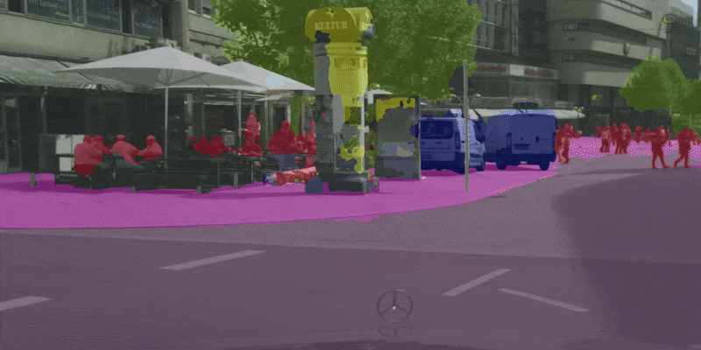
Segmentation
Notes:
https://github.com/ekzhang/fastseg/ (CUDA open source lib) (Written--i.e., in an email, permission granted...also usable under MIT license?)

Slide 10
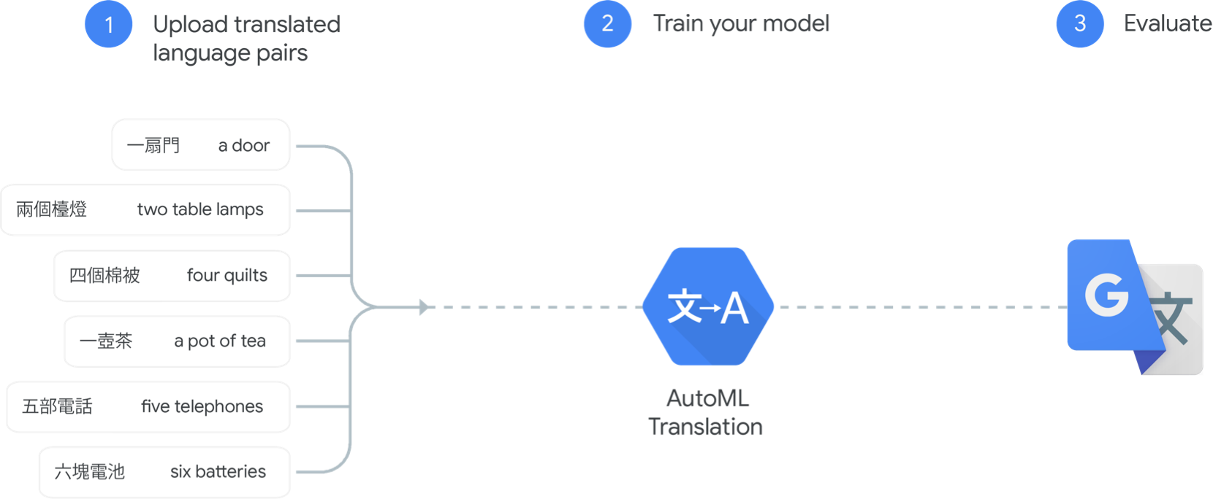
Machine Translation
Notes:
Do we have permissions to use stuff from cloud.google (it’s not TensorFlow):
https://cloud.google.com/translate

Slide 11
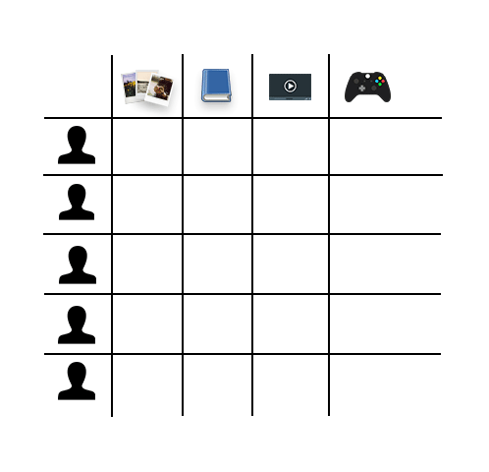
Recommendations

Slide 12
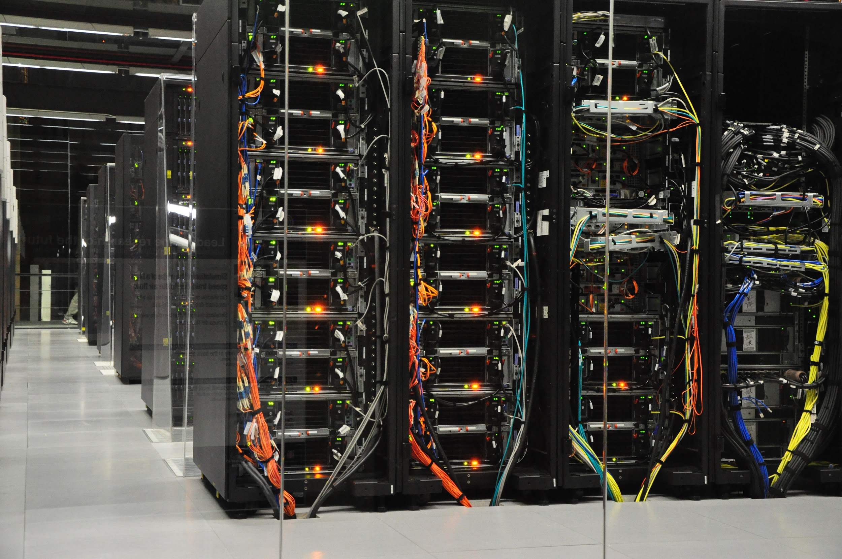
Datacenter
Notes:
https://commons.wikimedia.org/wiki/File:BSC-MareNostrum-C.JPG

Slide 13
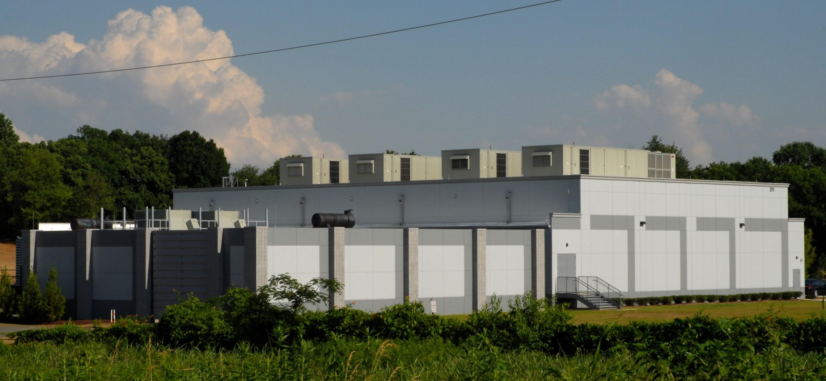
Datacenter
Notes:
https://commons.wikimedia.org/wiki/File:BSC-MareNostrum-C.JPG
https://search.creativecommons.org/photos/bbc499ba-dc75-4281-bcb3-d4bf60005715

Slide 14
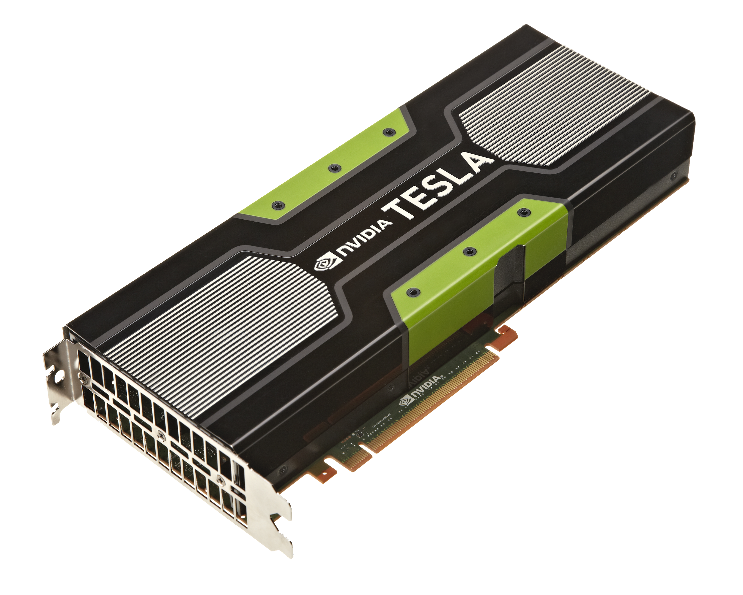
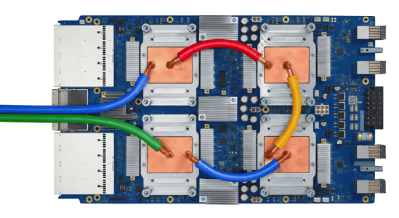
TPUs/GPUs
Notes:
https://commons.wikimedia.org/wiki/File:Tensor_Processing_Unit_3.0.jpg
https://cloud.google.com/tpu
https://search.creativecommons.org/photos/6e843e25-f76e-4b89-8549-1f1b52de6773

Slide 15

Bigger Is Not Always Better.
Notes:
https://commons.wikimedia.org/wiki/File:Noun_Project_lightbulb_icon_1263005_cc.svg
https://thenounproject.com/search/?q=lightbulb&i=1263005

Slide 16
Notes:
https://commons.wikimedia.org/wiki/File:BSC-MareNostrum-C.JPG

Slide 17
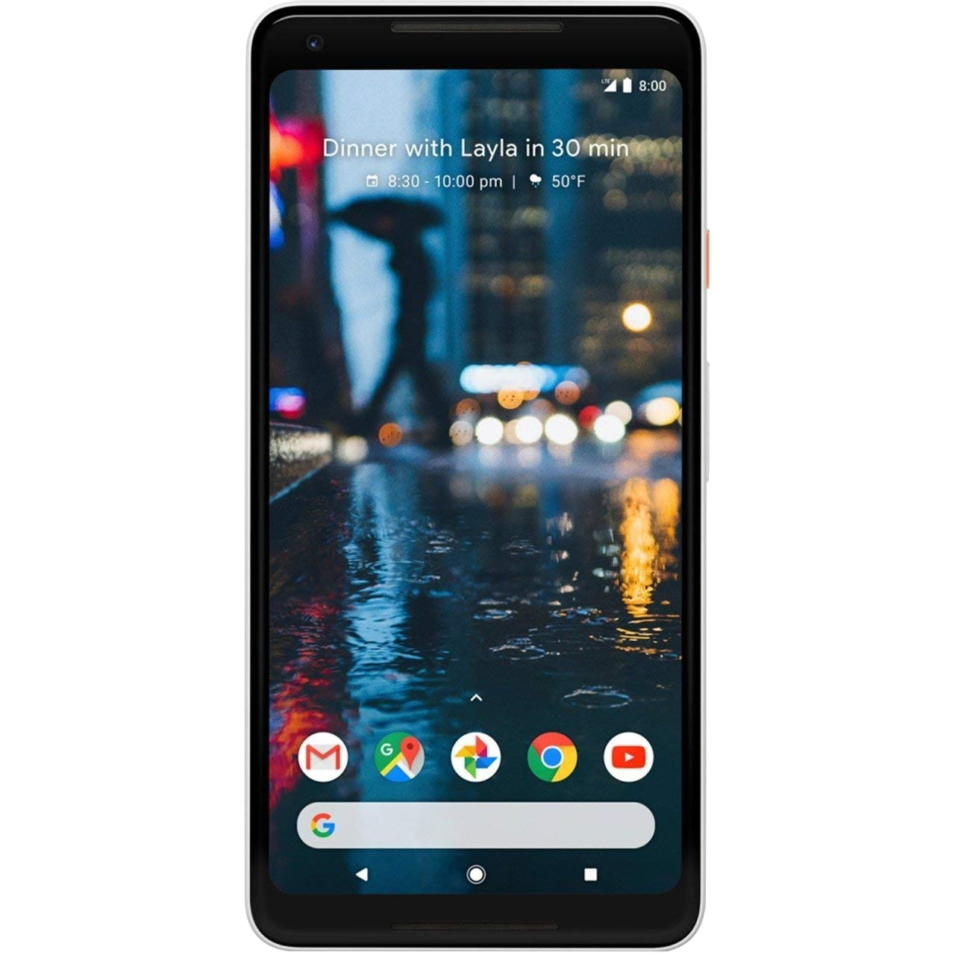
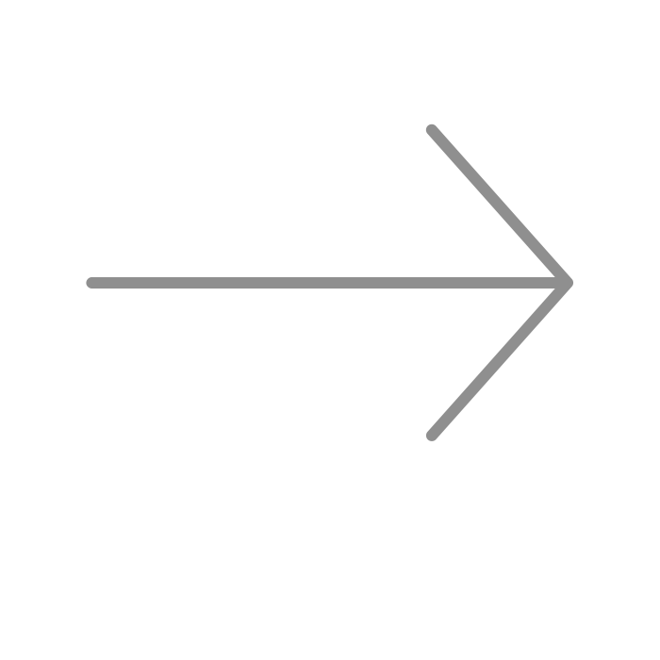
Notes:
https://commons.wikimedia.org/wiki/File:BSC-MareNostrum-C.JPG
https://search.creativecommons.org/photos/6e63331f-944b-4d61-8df3-5df190d63751

Slide 18
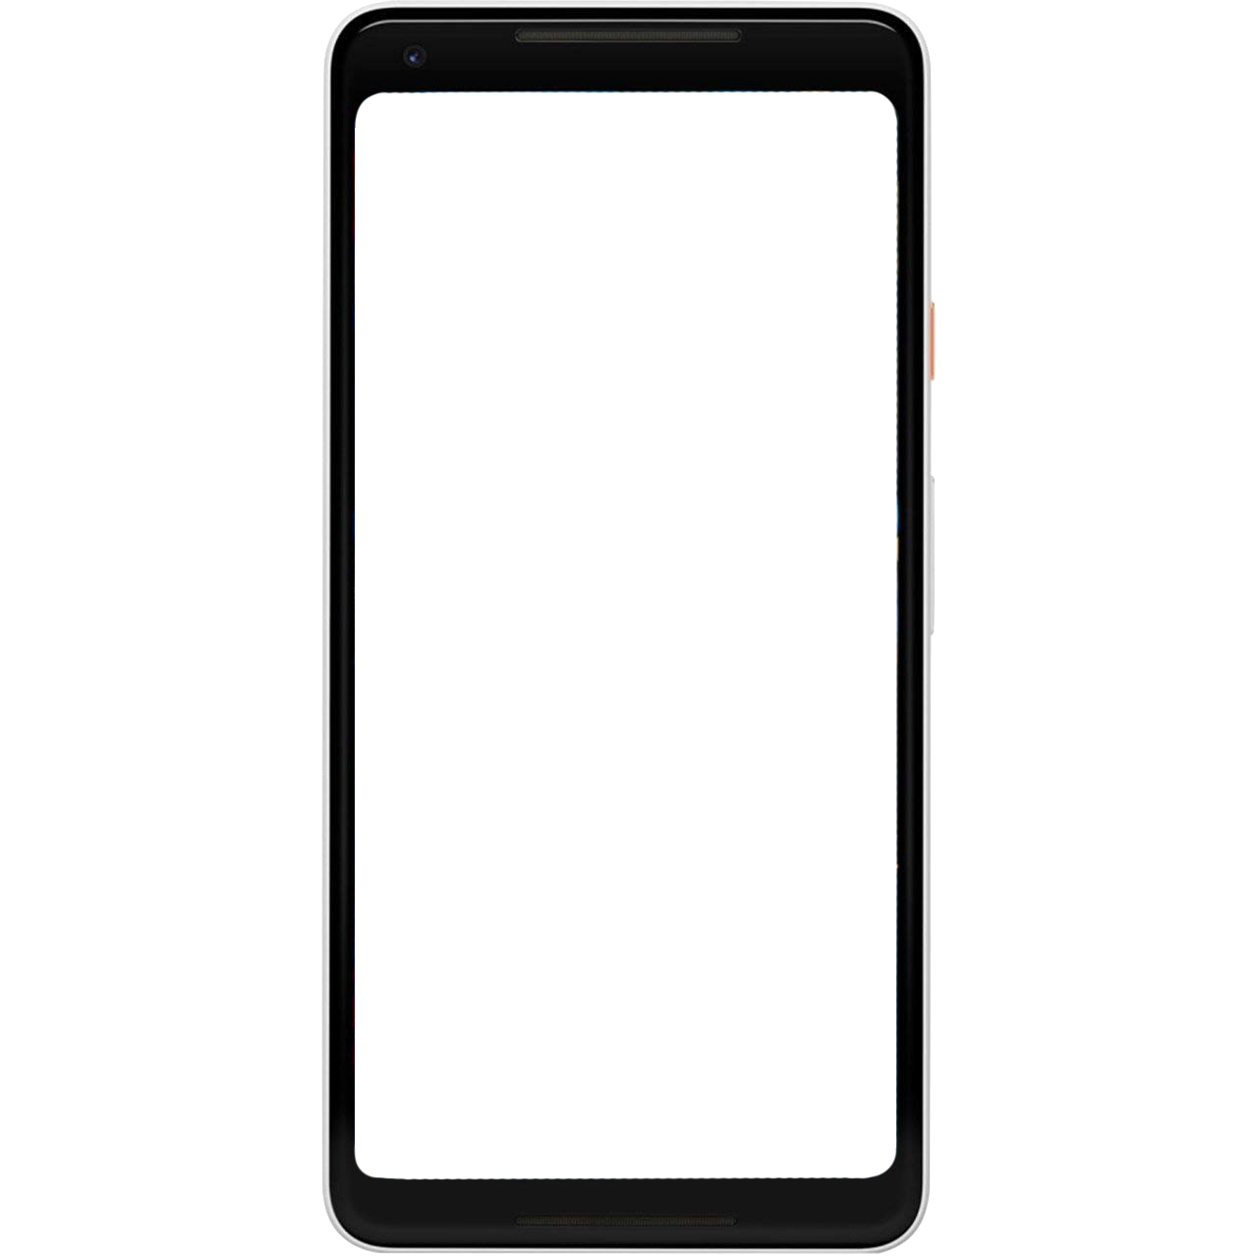
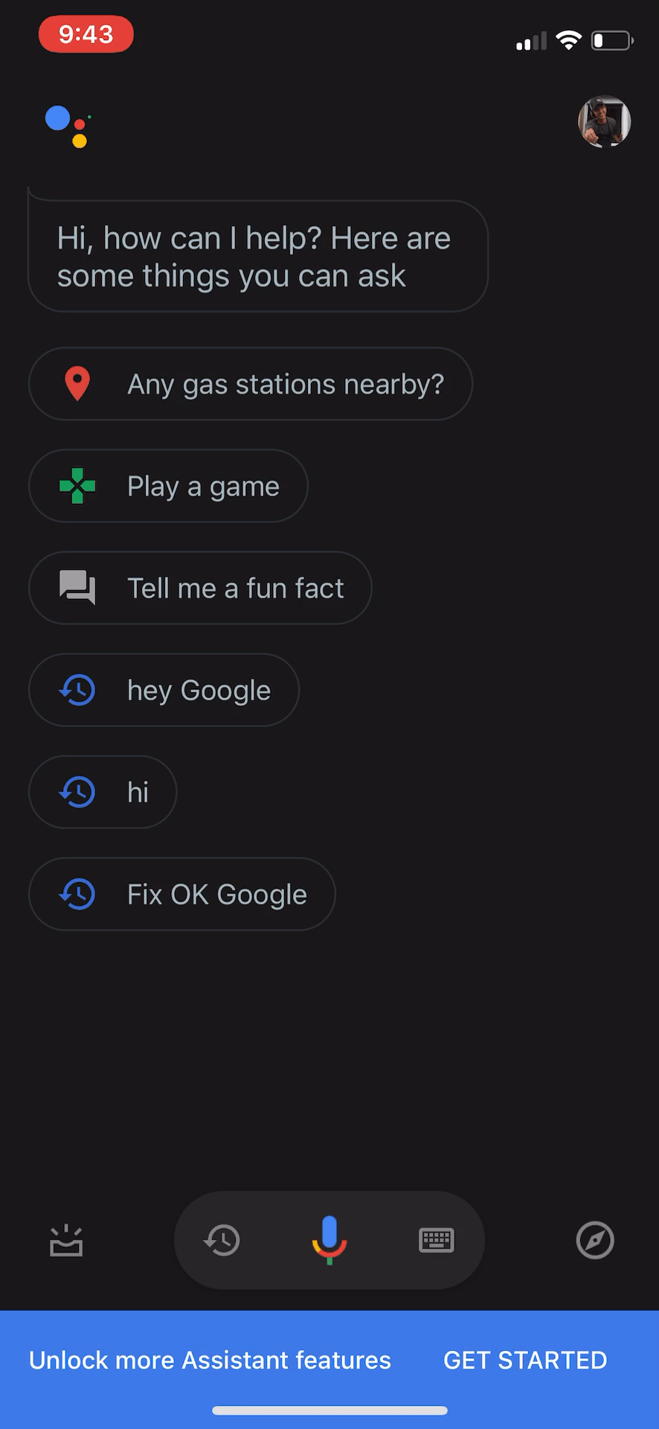
Notes:
https://commons.wikimedia.org/wiki/File:BSC-MareNostrum-C.JPG
https://search.creativecommons.org/photos/6e63331f-944b-4d61-8df3-5df190d63751

Slide 19
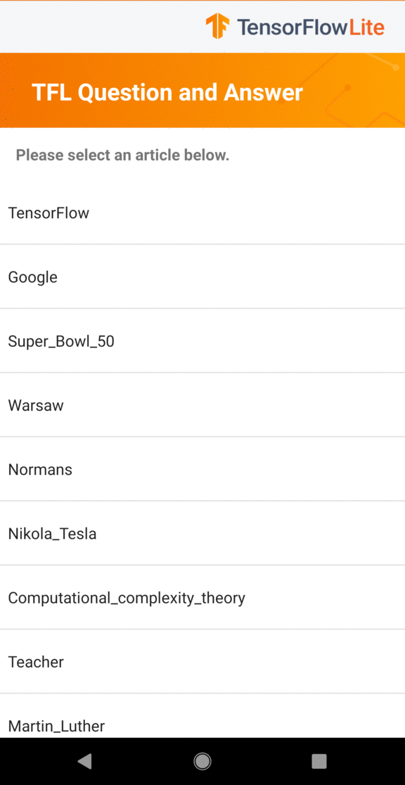
Notes:
https://commons.wikimedia.org/wiki/File:BSC-MareNostrum-C.JPG
https://search.creativecommons.org/photos/6e63331f-944b-4d61-8df3-5df190d63751

Slide 20
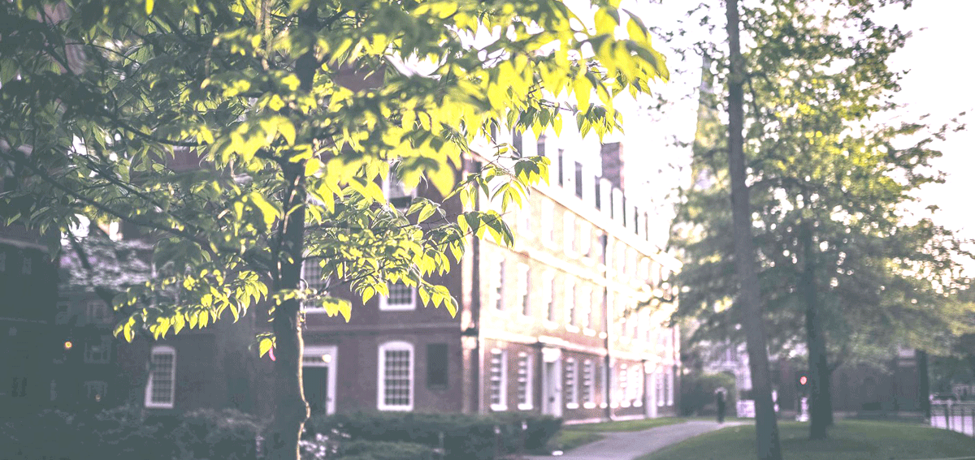
Notes:
https://commons.wikimedia.org/wiki/File:BSC-MareNostrum-C.JPG
https://search.creativecommons.org/photos/6e63331f-944b-4d61-8df3-5df190d63751
https://thenounproject.com/search/?q=enhance&i=123911

Slide 21
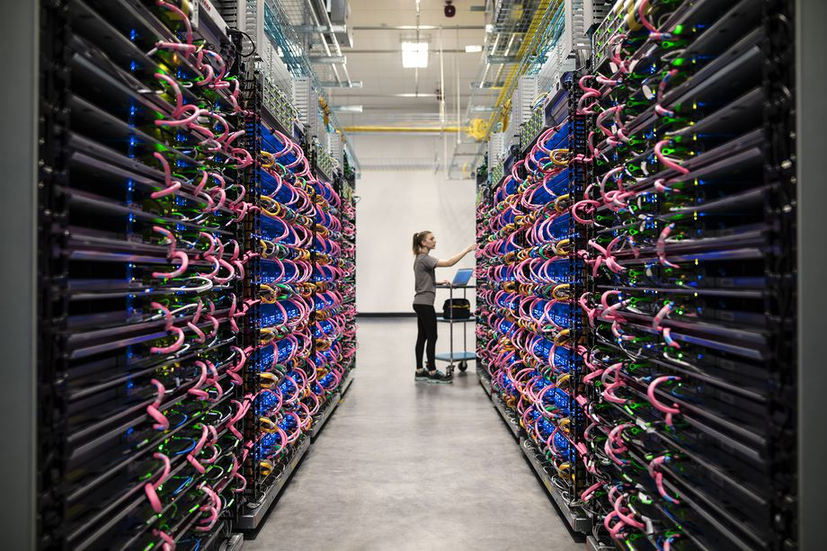
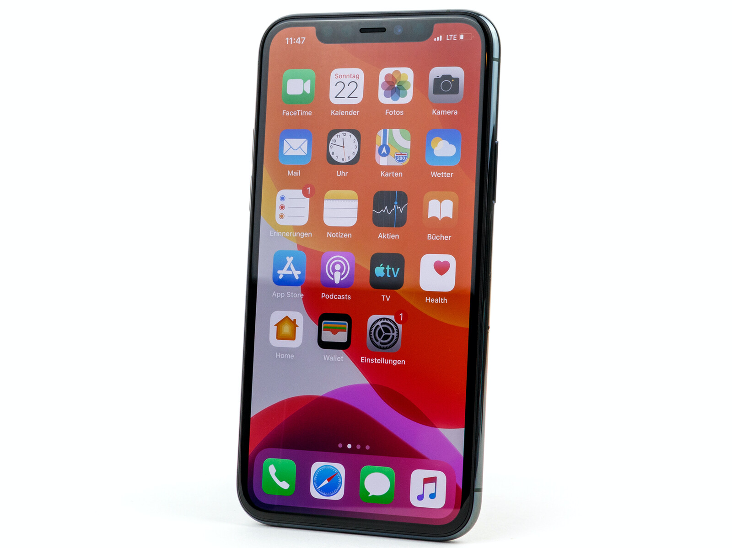
Why?
High power
Latency
Bandwidth
Power

Slide 22
Why?
High power
Low power
Latency
Bandwidth
Power

Slide 23
Why?
High power
High bandwidth
Low power
Latency
Bandwidth
Power

Slide 24
Why?
High power
High bandwidth
Low power
Low bandwidth
Latency
Bandwidth
Power

Slide 25
Why?
High power
High bandwidth
High latency
Low power
Low bandwidth
Latency
Bandwidth
Power

Slide 26
Why?
High power
High bandwidth
High latency
Low power
Low bandwidth
Low latency
Latency
Bandwidth
Power

Slide 27
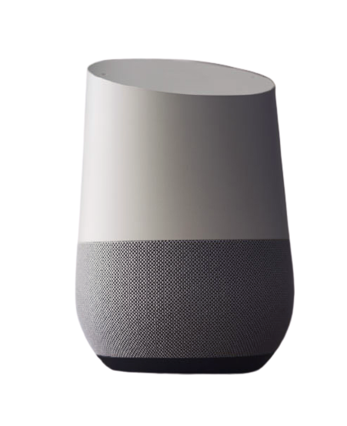
High power
High bandwidth
High latency
Low power
Low bandwidth
Low latency
Latency
Bandwidth
Power

Slide 28


Notes:
https://thenounproject.com/search/?q=battery&i=248203
https://thenounproject.com/search/?q=hear&i=1616288

Slide 29
Notes:
https://commons.wikimedia.org/wiki/File:Google_Home_sitting_on_table.jpg

Slide 30
Notes:
https://commons.wikimedia.org/wiki/File:Google_Home_sitting_on_table.jpg

Slide 31

Google Assistant
Notes:
https://commons.wikimedia.org/wiki/File:Google_Home_sitting_on_table.jpg

Slide 32
Endpoint Devices
Google Assistant
Notes:
https://search.creativecommons.org/photos/f8a09fce-468e-456a-bde9-47fcdd2a1fa2
https://search.creativecommons.org/photos/76bf4442-0a5c-4fb0-8194-42b98822ed9b
https://commons.wikimedia.org/wiki/File:Pixel_Buds_in_charging_case_with_product_box.jpg
https://search.creativecommons.org/photos/8d1958cc-d230-49e9-a2b1-c65e1aadd122
https://thenounproject.com/search/?q=signal&i=1438227

Slide 33
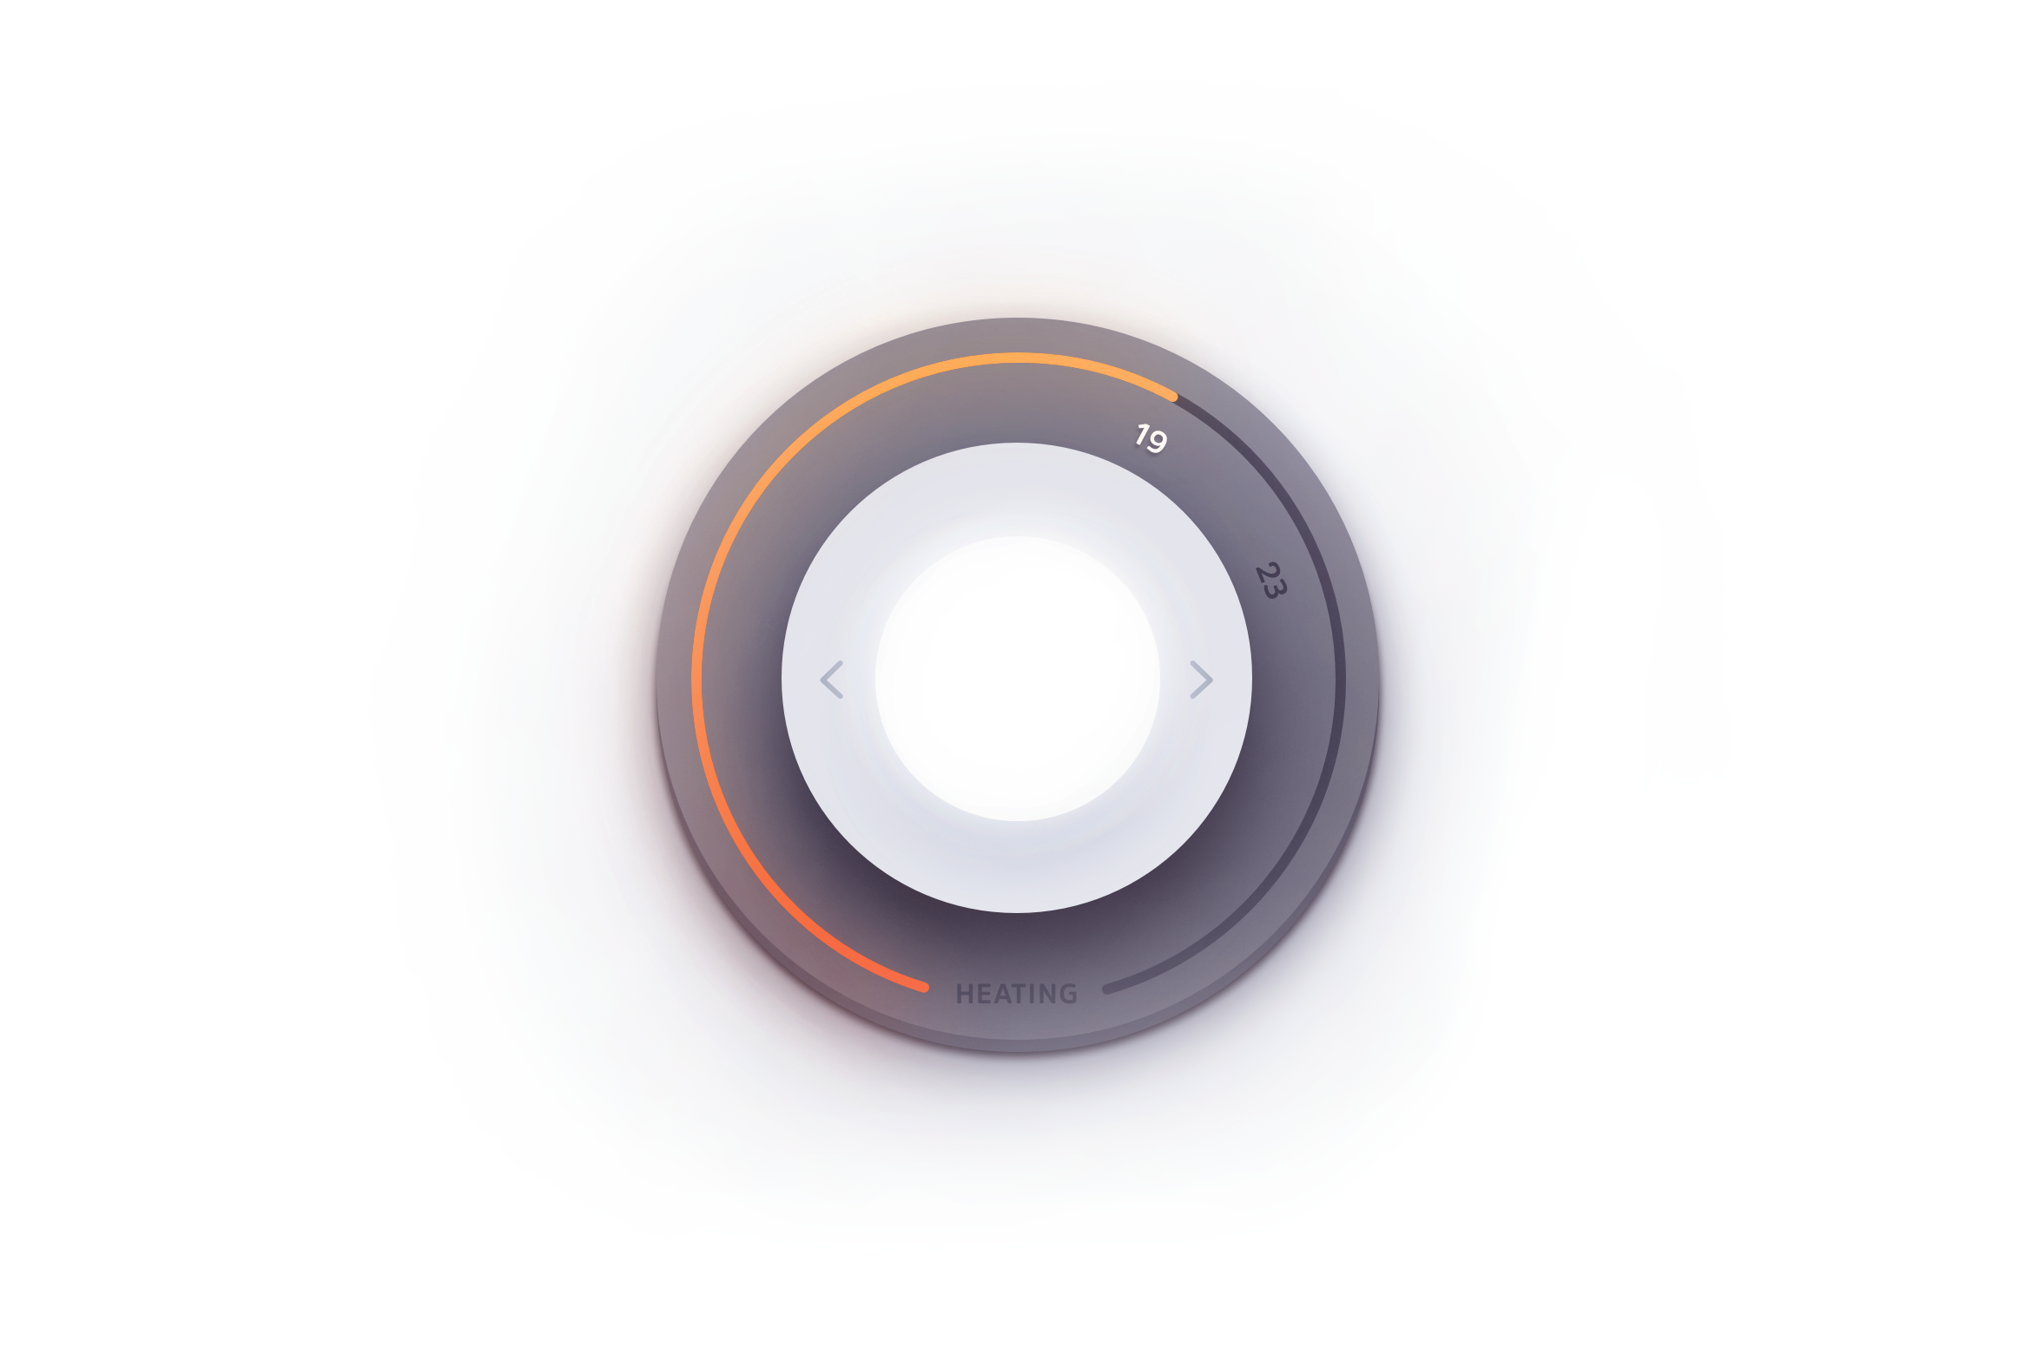
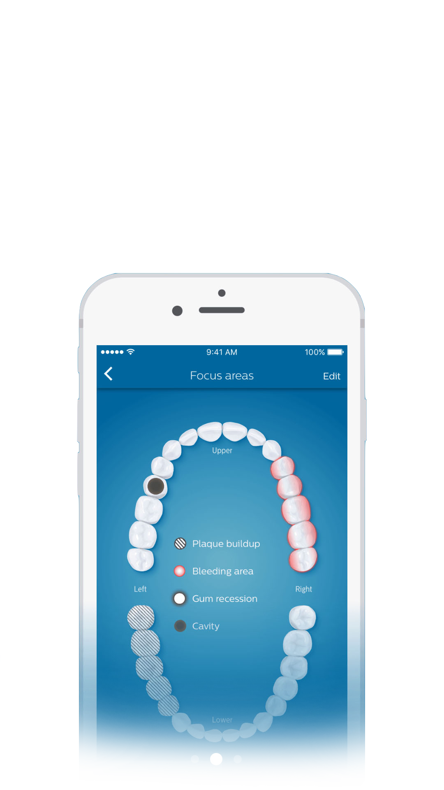
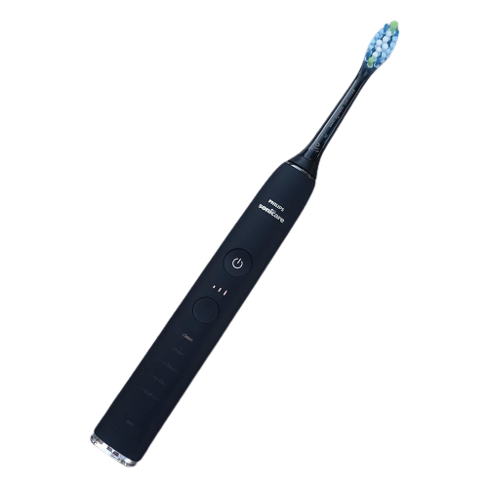
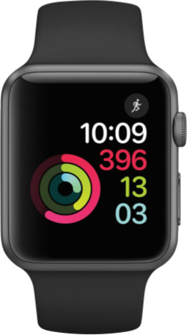
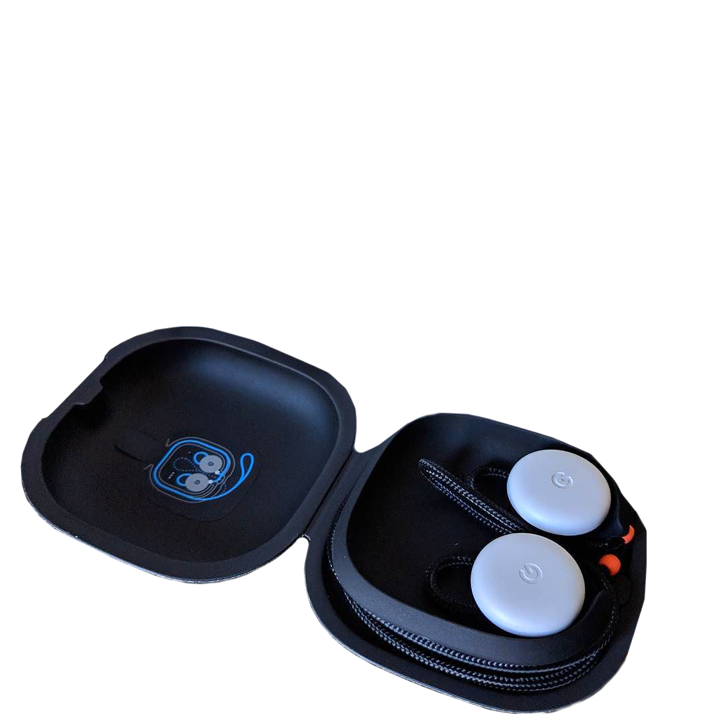
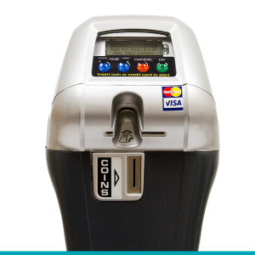

Endpoint Devices
nest
Google Assistant
Notes:
https://search.creativecommons.org/photos/f8a09fce-468e-456a-bde9-47fcdd2a1fa2
https://search.creativecommons.org/photos/76bf4442-0a5c-4fb0-8194-42b98822ed9b
https://commons.wikimedia.org/wiki/File:Apple_Watch_(Space_Grey_42mm).png
https://commons.wikimedia.org/wiki/File:Pixel_Buds_in_charging_case_with_product_box.jpg
https://search.creativecommons.org/photos/8d1958cc-d230-49e9-a2b1-c65e1aadd122
https://thenounproject.com/search/?q=signal&i=1438227

Slide 34
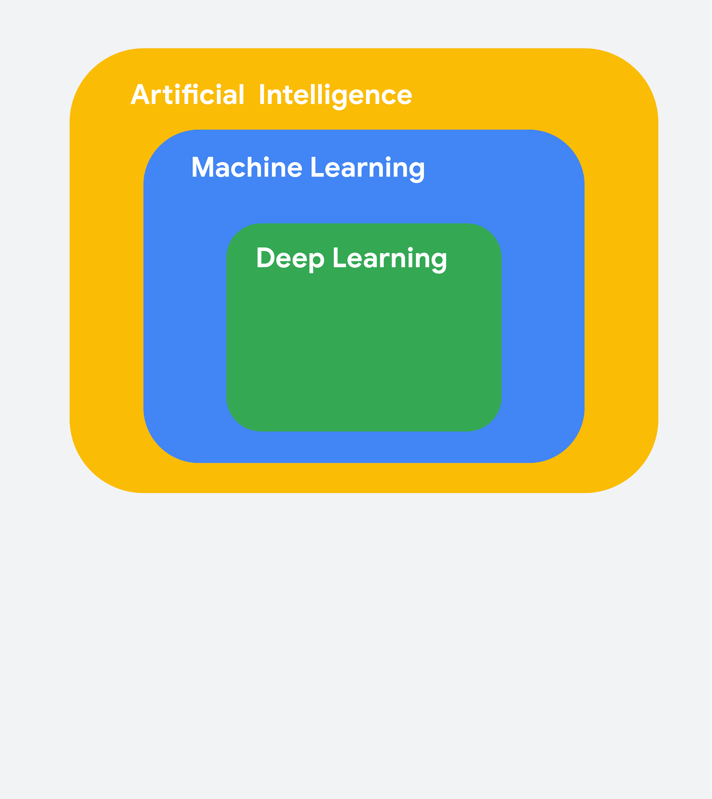
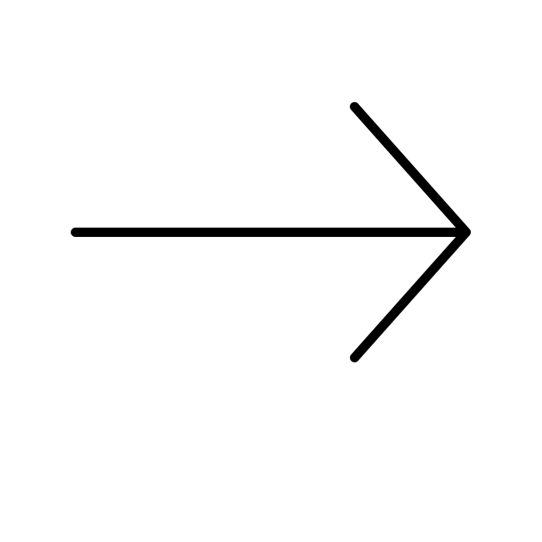
What is (Deep) Machine Learning?
Machine Learning is a subfield of Artificial Intelligence focused on developing algorithms that learn to solve problems by analyzing data for patterns
Deep Learning is a type of Machine Learning that leverages Neural Networks and Big Data

Slide 35
No Good Data Left Behind
5 Quintillion
bytes of data produced every day by IoT
<1%
of unstructured data is analyzed or used at all
Source: Harvard Business Review, What’s Your Data Strategy?, April 18, 2017
Cisco, Internet of Things (IoT) Data Continues to Explode Exponentially. Who Is Using That Data and How?, Feb 5, 2018

Slide 36
Summary
Half-screen. Show presenter.
ML has several diverse applications in the real-world
ML is increasingly moving from the cloud to endpoint devices
Endpoint devices are everywhere around us

Slide 37
Fullscreen. Show presenter.

